Slide 1
CSCI U511 01 Operating Systems AKM Jahangir A Majumder, PhD
Fall 2019 - Lecture 2
August 27, 2019
Note: Some slides are adapted from those used by previous instructors and some slides include figures from the textbook.

Slide 2
Review and Learning Outcomes
We will finish to discuss introduction to OS systems (Chap. 1) today
We will review materials covered in CSCI U 210 and 310 today
Please read the syllabus
We will have our first quiz on Thursday, September 5 which will cover lectures 1-3
HW 1 will post on Blackboard soon which is due on Tuesday, Sept. 3
The project proposal is due today.

Slide 3
Review: Today’s Operating Systems- Computers Cheap
Smartphones
Embedded systems
Laptops
Tablets
Virtual machines
Data center servers

Slide 4
Review: Tomorrow’s Operating Systems
Giant-scale data centers
Increasing numbers of processors per computer
Increasing numbers of computers per user
Very large scale storage

Slide 5
The major OS issues
structure: how is the OS organized?
sharing: how are resources shared across users?
naming: how are resources named (by users or programs)?
security: how is the integrity of the OS and its resources ensured?
protection: how is one user/program protected from another?
performance: how do we make it all go fast?
reliability: what happens if something goes wrong (either with hardware or with a program)?
extensibility: can we add new features?
communication: how do programs exchange information, including across a network?

Slide 6
Major issues in OS (2)
Concurrency: how are parallel activities created and controlled?
Scale and growth: what happens as demands or resources increase?
Persistence: how to make data last longer than programs
Compatibility & Legacy Apps: can we ever do anything new?
Distribution: Accessing the world of information
Accounting: who pays the bills, and how do we control resource usage?
These are engineering trade-offs
Based on objectives and constraints

Slide 7
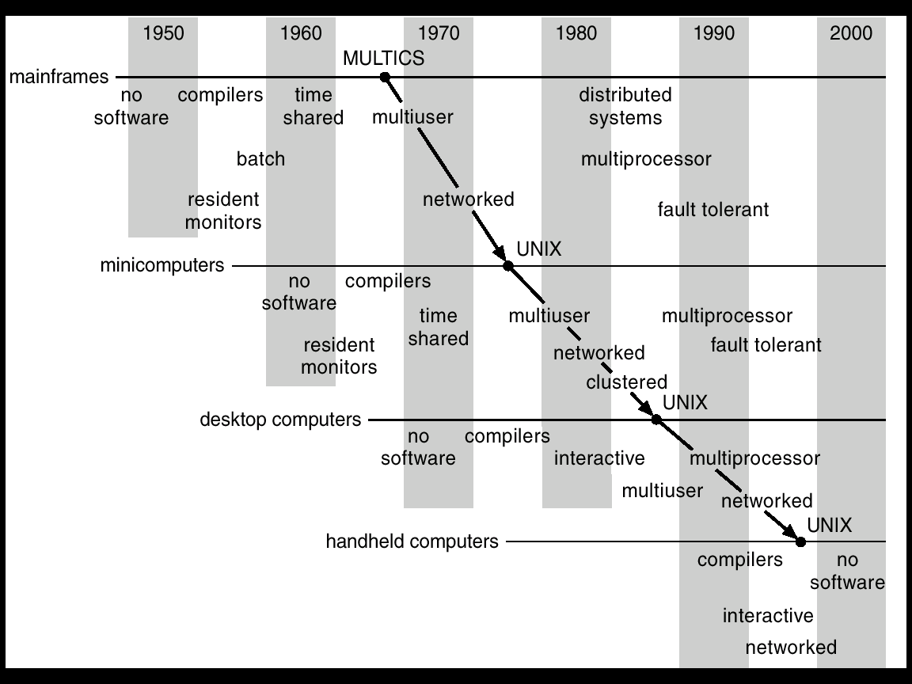
Progression of concepts and form factors
© Silberschatz, Galvin and Gagne

Slide 8
Has it all been discovered?
New challenges constantly arise
embedded computing (e.g., iPod)
sensor networks (very low power, memory, etc.)
peer-to-peer systems
ad hoc networking
scalable server farm design and management (e.g., Google)
software for utilizing huge clusters (e.g., MapReduce, Bigtable)
overlay networks (e.g., PlanetLab)
worm fingerprinting
finding bugs in system code (e.g., model checking)
Old problems constantly re-define themselves
the evolution of PCs recapitulated the evolution of minicomputers, which had recapitulated the evolution of mainframes
but the ubiquity of PCs re-defined the issues in protection and security

Slide 9
An illustration of architectural and OS functionality requirements
User program
OS

Slide 10
Parallel systems
Some applications can be written as multiple parallel threads or processes
can speed up the execution by running multiple threads/processes simultaneously on multiple CPUs
need OS and language primitives for dividing program into multiple parallel activities
need OS primitives for fast communication among activities
degree of speedup dictated by communication/computation ratio
many flavors of parallel computers today
SMPs (symmetric multi-processors, multi-core)
MPPs (massively parallel processors)
NOWs (networks of workstations)
computational grid (SETI @home)

Slide 11

Personal computing
Primary goal was to enable new kinds of applications
Bit mapped display
new classes of applications
new input device (the mouse)
Move computing near the display
why?
Window systems
the display as a managed resource
Local area networks [Ethernet]
why?
Effect on OS?

Slide 12
Client/server computing
Mail server/service
File server/service
Print server/service
Compute server/service
Game server/service
Music server/service
Web server/service
etc.

Slide 13
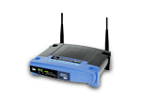
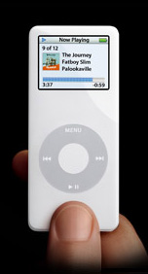
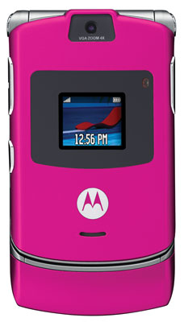
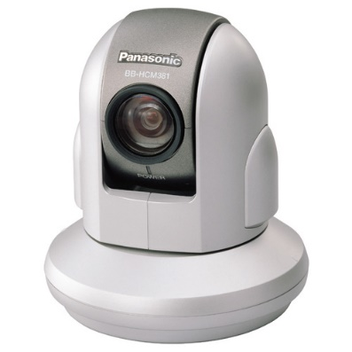
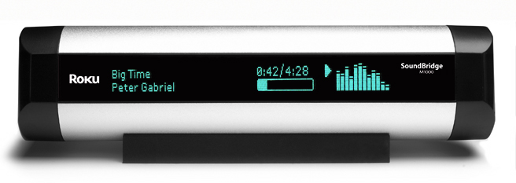
Embedded/mobile/pervasive computing
Pervasive computing
cheap processors embedded everywhere
how many are on your body now? in your car?
cell phones, PDAs, network computers, …
Typically very constrained hardware resources
slow processors
very small amount of memory (e.g., 8 MB)
no disk
typically only one dedicated application
limited power
But this is changing rapidly!

Slide 14
In Lecture Review
We finished our coverage on Chapter 1
We will begin our coverage on Chap 2: Kernels and Processes
But we will review U210 course syllabi before we start to discuss Chap 2

Slide 15
Review on U210

Slide 16
Performance: CPU Time
Performance improved by
Reducing number of clock cycles
Increasing clock rate
Hardware designer must often trade off clock rate against cycle count

Slide 17
Performance Summary
Performance depends on
Algorithm: affects IC, possibly CPI
Programming language: affects IC, CPI
Compiler: affects IC, CPI
Instruction set architecture: affects IC, CPI, T_{c}

Slide 18
Different Logic Gates
A
A⋅B
A
(A.B)’
AND
NAND
B
B
A
A+B
A
(A+B)’
OR
NOR
B
B
A
(A+B)
A
A’
NOT
XOR
B
You need to memorize their symbols and functions

Slide 19
Boolean Algebra and Truth Table
Boolean algebra can be used to describe binary logic.
Boolean algebra operators (in the order of priority):
() : Parenthesis
‘ : NOT
⋅ : AND
+ : OR
Truth table can be used to represent input-output relations of a digital system.
You should be able to derive a truth table for a given logic circuit or Boolean algebra presentation and vice versa.

Slide 20
Example: Truth Table, Boolean Algebra, and Digital Logic Circuit
A | B | C | B⋅C | A+B⋅C
0 | 0 | 0 | 0 | 0
0 | 0 | 1 | 0 | 0
0 | 1 | 0 | 0 | 0
0 | 1 | 1 | 1 | 1
1 | 0 | 0 | 0 | 1
1 | 0 | 1 | 0 | 1
1 | 1 | 0 | 0 | 1
1 | 1 | 1 | 1 | 1
A
A+B⋅C
B
C
B⋅C

Slide 21
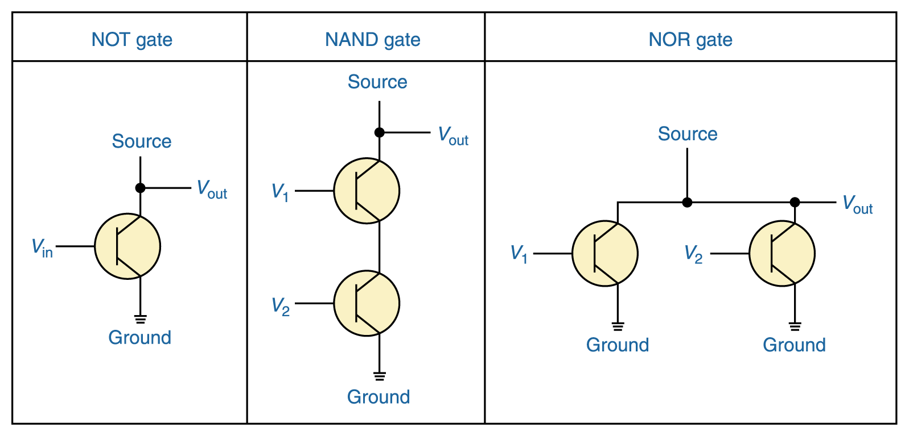
Constructing Gates
It turns out that, because the way a transistor works, the easiest gates to create are the NOT, NAND, and NOR gates

Slide 22
Laws of Boolean Algebra
Identity law
A + 0 = A
A⋅1 = A
Zero and One laws
A + 1 = 1
A ⋅0 = 0
Inverse laws
A + A’ = 1
A⋅ A’ = 0
Commutative laws
A + B = B + A
A . B = B . A
Associative laws
A + (B + C) = (A + B) + C
A . (B . C) = A . (B . C)
Distributive laws
A. (B + C) = (A.B) + (B.C)
A+(B . C) = (A+B) . (A+C)
DeMorgan’s laws
(A⋅B)’=A’+B’
(A+B)’=A’ ⋅B’

Slide 23
Binary Numbers
Some terminology and units
Bit (b): A single binary digit
Nib: 4 bits
Byte (B): 8-bits
Word: A group of bits of any size (often 4 bytes).
kb: 2¹⁰ bits = 1024 bits (kB = 2¹⁰ bytes)
Mb: 2²⁰ bits =1,048,576 bits (MB = 2²⁰ bytes)
Gb: 2³⁰ bits = 1,073,741,820 bits (GB = 2³⁰ bytes)
MSB: Most significant bit (leftmost digit of binary #)
LSB: Least significant bit (rightmost digit of bin. #)

Slide 24
Binary to Decimal Conversion
Binary Number:
···b₃b₂b₁b₀ (each bit b_{i} is 0 or 1)
Its decimal value is:
b₀×2⁰ + b₁×2¹ + b₂×2² + b₃×2³ + ···
= b₀×1 + b₁×2 + b₂×4 + b₃×8 + ···
Examples: 1110₂ Decimal value is:
1111₂ Decimal value is:
110010₂ Decimal value is:
111111₂ Decimal value is:
14
15
50
63
Check your understanding:
N bits → 2^{N} combinations → decimal numbers 0, 1, 2, 3, …, 2^{N} - 1
The largest number: 11…11₂ = 2^{N}-1 (decimal)
N bits, all ones

Slide 25
Other Conversions
Convert decimal to hex
Use the successive division method described previously (for decimal to binary), but divide by 16 instead of 2.
Convert binary to hex
A hex digit is equivalent to 4 bits.
Divide binary number into groups of 4 bits, starting from the right.
Convert each 4 bit group into one hex digit.
Convert hex to binary
Convert each hex digit to its 4-bit binary equivalent.
String the bits together.
Note: Computationally, it’s easy to convert between bases that are powers of 2, as indicated in the binary to hex conversion technique above.

Slide 26
Other Conversions
Convert decimal to Octal
Use the successive division method described previously (for decimal to binary), but divide by 8 instead of 2.
Convert binary to Octal
A octal digit is equivalent to 3 bits.
Divide binary number into groups of 3 bits, starting from the right.
Convert each 3 bit group into one octal digit.
Convert octal to binary
Convert each octal digit to its 3-bit binary equivalent.
String the bits together.
(examples on next slide)

Slide 27
Fractions
Binary to Decimal Conversion
Binary number: 0.b₋₁b₋₂b₋₃b₋₄···
Decimal value: b₋₁×2⁻¹ + b₋₂×2⁻² + b₋₃×2⁻³ + b₋₄×2⁻⁴ + ···
Example: 0.101₂ = 1×2⁻¹ + 0×2⁻² + 1×2⁻³ = 0.625₁₀
Decimal to Binary Conversion: Successive multiplication by 2
Example: Decimal number 0.6875
0.6875×2 = 1.375 → b₋₁ = 1 and 1.375-1 = 0.375
0.375×2 = 0.75 → b₋₂ = 0 and 0.75-0 = 0.75
0.75×2 = 1.5 → b₋₃=1 and 1.5-1 = 0.5
0.5×2 = 1 → b₋₄=1 and 1-1 = 0
Binary representation: 0.1011

Slide 28
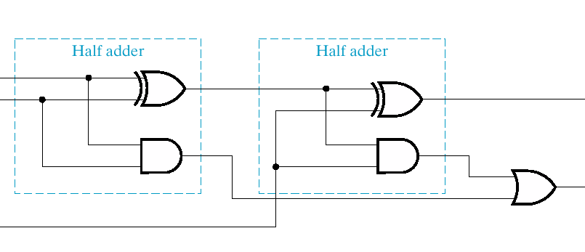
1 Bit Full Adder Implementation
a
sum
b
carry out
carry in
s
=
a
⊕
b
⊕
c_{in}
=
+
⊕
c_{out}
a
b
(
a
b
)
c_{in}

Slide 29
Binary Math: 2’s Complement
In binary world, people use 2’s complement to represent signed integer and implement subtraction.
The procedure of getting 2’s complement of a given number:
Invert every bit
Then add 1
For n bit signed integer, its representation is -2^{n-1} ~ 2^{n-1}-1
Example
11001100₂ = - (00110100)₂ = -52₁₀
10000000₂ = -128₁₀

Slide 30
2’s Complement Adder/Subtractor
Subtraction can be done by addition of the 2's Complement.
1. Complement each bit
2. Add 1 to the result.
The circuit shown computes A + B and A – B:
For S = 1, subtract, the 2’s complement of B is formed by using XORs to form the 1’s comp and adding the 1 applied to C₀.
For S = 0, add, B is passed through unchanged

Slide 31
Binary Math: Overflow Detection
Overflow happens when the calculation result is beyond the representation range for given number of bits.
Overflow might happen in one of following situations:
Positive + Positive
Negative + Negative
Positive – Negative
Negative – Positive
Important: You should determine whether an overflow happen by checking sign bits.
Example:
Overflow: 11000000+10000000=01000000 (the extra carry out bit is discarded)
Overflow: 01000000+01000000=10000000 (no extra bit)
No Overflow 01000000+11000000=00000000 (the extra carry out bit is discarded)

Slide 32
Multiplication and Division by Shifting Bits
We will cover multiplication in great details later. However, some simple multiplication can be accomplished simply by shifting the bit sequence.

Slide 33
Shift Operations
Move (shift) all the bits in a word to the left or right by a number of bits.
Example: shift right by 8 bits
0001 0010 0011 0100 0101 0110 0111 1000
0000 0000 0001 0010 0011 0100 0101 0110
Example: shift left by 8 bits
0001 0010 0011 0100 0101 0110 0111 1000
0011 0100 0101 0110 0111 1000 0000 0000

Slide 34
Shifting and Multiplication
Shift Left a binary number by i bits will give the same result as multiplying by 2^{i}. (True or False)
Shift Right a binary number by i bits will give the same result as dividing by 2^{i}. (True or False)

Slide 35
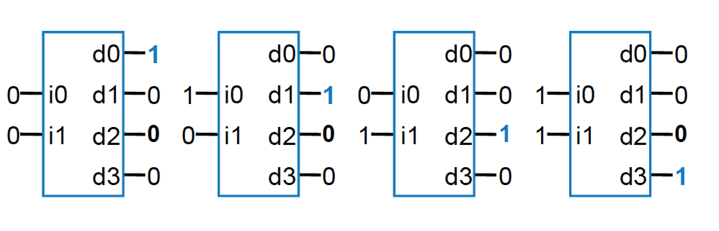
Decoder
Popular combinational logic building block, in addition to logic gates
Collection of logic gates which are arranged in a specific way that converts input binary number to one high output
2-input decoder: four possible input binary numbers... So has four outputs, one for each possible input binary number

Slide 36
Building of 4-to-1-line Multiplexer
2-to-2²-line decoder
2² × 2 AND-OR

Slide 37
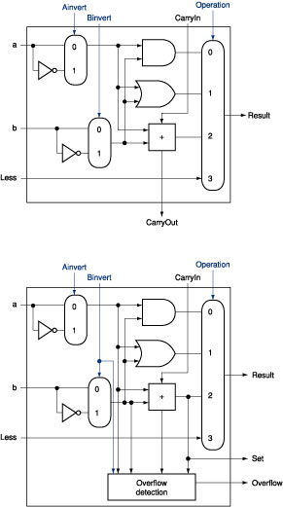
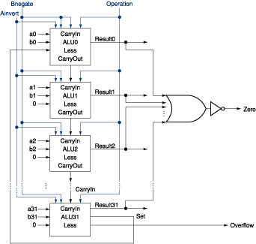
The ALU Diagram
ALU control lines: 0000 = and 0001 = or 0010 = add 0110 = subtract 0111 = slt 1100 = NOR
ALU 0~30
ALU 31
Can this ALU implement a NAND function?

Slide 38
Introduction to Sequential Circuits
Inputs
Outputs
Combina-tional
Logic
A Sequential circuit contains:
Storage elements: Latches or Flip-Flops
Combinatorial Logic:
Implements a multiple-output switching function
Inputs are signals from the outside.
Outputs are signals to the outside.
Other inputs, State or Present State, are signals from storage elements.
The remaining outputs, Next State are inputs to storage elements.
Storage Elements
Next
State
State

Slide 39
Storage Element’s Timing Model
Clk
Setup
Hold
D
Q
D
Don’t Care
Don’t Care
Clock-to-Q
Q
Unknown
Setup Time: Input must be stable BEFORE trigger clock edge
Hold Time: Input must REMAIN stable after trigger clock edge
Clock-to-Q time:
Output cannot change instantaneously at the trigger clock edge
Similar to delay in logic gates, two components:
Internal Clock-to-Q
Load dependent Clock-to-Q
Typical for class: 1ns Setup, 0.5ns Hold
Notes:
So far we have been looking at combinational logic, let’s look at the timing characteristic of a storage element.
The storage element you will use is a D type flip-flop trigger on the negative clock edge.
In order for the data to latch into the flip flop correctly, the input must be stable slightly before the falling edge of the clock. This time is called the Setup time.
After the clock edge has arrived, the data must remain stable for a short amount of time AFTER the trigger clock edge. This is called the hold time.
The output cannot change instantaneously at the trigger clock edge. The time it takes for the output to change to its new value after the clock is called the Clock-to-Q time.
Similar to delay in logic gates, the Clock-to-Q time has two components:
(a) The internal Clock-to-Q time: the time it takes the output to change if output load is zero.
(b) And the load dependent Clock-to-Q time.
+2 = 50 min. (Y:30)

Slide 40
Machine Format
Our processor’s machine code format is given below
[load, regad1, regad2, des_regad, aluop]
load signal: 1 (read from external input), 0 (read from ALU)
regad1: the address of the register for the ALU input 1
regad2: the address of the register for the ALU input 2
des_regad: the address of the destination register which data is written into
aluop: the ALU function selection
There are 16 registers and 8 ALU functions.
Question: Based on the above description of the processor, how many bits each command should have?

Slide 41
MIPS Assembly Language
We’ll be working with the MIPS instruction set architecture
developed in 1985
means “Microprocessor without Interlocked Pipeline Stages”
similar to other architectures developed since the 1980's
almost 100 million MIPS processors manufactured in 2002
used by NEC, Nintendo, Cisco, Silicon Graphics, Sony, …
a Reduced Instruction Set Computer (RISC) Assembly Language
Instruction Category:
Arithmetic: Add, Subtract,…
Data Transfer: Load Word,…
Logical: And, Or,…
Conditional Branch: Branch on Equal,…
Unconditional Jump: Jump

Slide 42
Assembly Variables: Registers Cont..
Registers are numbered from 0 to 31
Each register can be referred to by number or name
Number references:
$0, $1, $2, … $30, $31

Slide 43
MIPS Registers
USE Number Name
The constant 0 $0 $zero
Reserved for Assembler $1 $at
Return Values $2-$3 $v0-$v1
Arguments $4-$7 $a0-$a3
Temporary $8-$15 $t0-$t7
Saved Temporaries $16-$23 $s0-$s7
Temporary $24-$25 $t8-$t9
Used by Kernel $26-$27 $k0-$k1
Global Pointer $28 $gp
Stack Pointer $29 $sp
Frame Pointer $30 $fp
Return Address $31 $ra

Slide 44
Registers vs. Memory
Arithmetic instructions operands must be registers, — only 32 registers provided
Which computer components do registers belongs to?
Compiler associates variables with registers
What about programs with lots of variables?
Control
Input
Memory
Datapath
Output
Processor
I/O

Slide 45
Review: MIPS Instruction Format
3 Instruction Formats: all 32 bits wide
OP
rs
rt
rd
sa
funct
OP
rs
rt
immediate
OP
jump target

Slide 46
Machine Language: R-Type
Numeric version of instructions is called machine language
Instructions, like registers and words of data, are also 32 bits long
Example: add $t0, $s1, $s2
registers have numbers, $t0=8, $s1=17, $s2=18
Instruction Format: add $t0, $s1, $s2
000000 10001 10010 01000 00000 100000 op rs rt rd shamt funct
Can you guess what the field names stand for?
Notes:
Board work: Binary Numbers

Slide 47
Machine Language: I-Type
Consider the addi instructions,
What would the regularity principle have us do?
New principle: Good design demands a compromise
Introduce a new type of instruction format
I-type for immediates
other format was R-type for register
Example: addi $s1, $s2, 100 8 18 17 100 op rs rt 16 bit number

Slide 48
MIPS Fields
op: Basic operation of the instruction, opcode
rs: The first register source operand
rt: The second register source operand
rd: The register destination operand.
shamt: Shift amount
funct: Function

Slide 49
Assembly Operands: Memory
C variables map onto registers; what about large data structures like arrays?
1 of 5 components of a computer: memory contains such data structures
But MIPS arithmetic instructions only operate on registers, never directly on memory.
Data transfer instructions transfer data between registers and memory:
Memory to register
Register to memory

Slide 50
Anatomy: 5 components of any Computer
Registers are in the datapath of the processor; if operands are in memory, we must transfer them to the processor to operate on them, and then transfer back to memory when done.
Personal Computer
Computer
Processor
Memory
Devices
Control
(“brain”)
Input
Store (to)
Datapath
Registers
Load (from)
Output
These are “data transfer” instructions…
Notes:
That is, any computer, no matter how primitive or advance, can be divided into five parts:
1. The input devices bring the data from the outside world into the computer.
2. These data are kept in the computer’s memory until ...
3. The datapath request and process them.
4. The operation of the datapath is controlled by the computer’s controller.
All the work done by the computer will NOT do us any good unless we can get the data back to the outside world.
5. Getting the data back to the outside world is the job of the output devices.
The most COMMON way to connect these 5 components together is to use a network of busses.

Slide 51
Data Transfer: Memory to Reg (1/4)
To transfer a word of data, we need to specify two things:
Register: specify this by # ($0 - $31) or symbolic name ($s0,…, $t0, …)
Memory address: more difficult
Think of memory as a single one-dimensional array, so we can address it simply by supplying a pointer to a memory address.
Other times, we want to be able to offset from this pointer.
Remember: “Load FROM memory”

Slide 52
Data Transfer: Memory to Reg (3/4)
Load Instruction Syntax:
1 2, 3(4)
where
1) operation name
2) register that will receive value
3) numerical offset in bytes
4) register containing pointer to memory
MIPS Instruction Name:
lw (meaning Load Word, so 32 bits or one word are loaded at a time)

Slide 53
Data Transfer: Memory to Reg (4/4)
Data flow
Example: lw $t0,12($s0)
This instruction will take the pointer in $s0, add 12 bytes to it, and then load the value from the memory pointed to by this calculated sum into register $t0
Notes:
$s0 is called the base register
12 is called the offset
offset is generally used in accessing elements of array or structure: base reg points to beginning of array or structure

Slide 54
Data Transfer: Reg to Memory
Also want to store from register into memory
Store instruction syntax is identical to Load’s
MIPS Instruction Name:
sw (meaning Store Word, so 32 bits or one word are loaded at a time)
Example: sw $t0,12($s0)
This instruction will take the pointer in $s0, add 12 bytes to it, and then store the value from register $t0 into that memory address
Remember: “Store INTO memory”
Data flow

Slide 55
The First Program: Hello World
.text
.globl main
main:
li $v0, 4
la $a0, str
syscall # print string
li $v0, 10
syscall # exit (you must use syscall #10 to exit)
.data
str: .asciiz "Hello World!!!"

Slide 56
MIPS Data Transfer Instructions Example
Word Address
C code: A[12] = h + A[8]; MIPS code: lw $t0, 32($s3) # load word add $t0, $s2, $t0 sw $t0, 48($s3) # store word
$s3: base address (as called index register)
Can refer to registers by name (e.g., $s2, $t2) instead of number
Store word has destination last
Remember arithmetic operands are registers, not memory! Can’t write: add 48($s3), $s2, 32($s3)
Byte Address

Slide 57
More Notes about Memory: Alignment
MIPS requires that all words start at byte addresses that are multiples of 4 bytes
Last hex digit of address is:
0 1 2 3
Aligned
0, 4, 8, or C_{hex}
1, 5, 9, or D_{hex}
Not
Aligned
2, 6, A, or E_{hex}
3, 7, B, or F_{hex}
Called Alignment: objects must fall on address that is multiple of their size.

Slide 58
MIPS Control Instruction I: Conditional Branch
Decision making instructions
alter the control flow,
i.e., change the "next" instruction to be executed
MIPS conditional branch instructions:
bne $t0, $t1, Label : if ($t0!=$t1) go to Label beq $t0, $t1, Label : if ($t0==$t1) go to Label
Example: if (i==j) h = i + j; bne $s0, $s1, Label add $s3, $s0, $s1 Label: ....

Slide 59
MIPS Control Instruction II: Unconditional Jump
MIPS unconditional branch instructions: j label
Example: if (i!=j) beq $s4, $s5, Lab1 h=i+j; add $s3, $s4, $s5 else j Lab2 h=i-j; Lab1: sub $s3, $s4, $s5 Lab2: ...
Technically, it’s the same as:
beq $0,$0,label
since it always satisfies the condition.

Slide 60
Example: Compiling C if into MIPS (1/2)
Compile by hand
if (i == j) f=g+h; else f=g-h;
Use this mapping: f: $s0 g: $s1 h: $s2 i: $s3 j: $s4
(true) i == j
(false) i != j
i == j?
f=g+h
f=g-h
Exit

Slide 61
Example: Compiling C if into MIPS (2/2)
Compile by hand
if (i == j) f=g+h; else f=g-h;
(true) i == j
(false) i != j
i == j?
f=g+h
f=g-h
Final compiled MIPS code:
beq $s3,$s4,True # branch i==j sub $s0,$s1,$s2 # f=g-h(false) j Fin # goto Fin True: add $s0,$s1,$s2 # f=g+h (true) Fin:
Note: Compiler automatically creates labels to handle decisions (branches). Generally not found in HLL code.
Exit

Slide 62
Inequalities in MIPS (1/5)
Until now, we’ve only tested equalities (== and != in C). General programs need to test < and > as well.
Create a MIPS Inequality Instruction:
“Set on Less Than”
Syntax: slt reg1,reg2,reg3
Meaning: reg1 = (reg2 < reg3);
if (reg2 < reg3) reg1 = 1; else reg1 = 0;
Usually, “set” means “set to 1”, “reset” means “set to 0”.
Same thing…

Slide 63
Inequalities in MIPS (2/5)
How do we use this? Compile by hand: if (g < h) goto Less; #g:$s0, h:$s1
Answer: compiled MIPS code…
slt $t0,$s0,$s1 # $t0 = 1 if g<h bne $t0,$0,Less # goto Less # if $t0!=0 # (if (g<h)) Less:
Branch if $t0 != 0 ➔ (g < h)
Register $0 always contains the value 0, so bne and beq often use it for comparison after an slt instruction.
A slt ➔ bne pair means if(… < …)goto…

Slide 64
Inequalities in MIPS (3/5)
We covered two pseudo instructions, li and la, in our SPIM tutorial session.
The following pseudo instruction is also useful:
"blt $s1, $s2, Label“
called “branch on less than”
can now build general control structures
Note that the assembler needs a register ($at: assembler temporary) to do this,
there are policy of use conventions for registers
Notes:
Board work: Binary Numbers

Slide 65
Inequalities in MIPS (4/5)
Now, we can implement <, but how do we implement >, ≤ and ≥ ?
We could add 3 more instructions, but:
MIPS goal: Simpler is Better
Can we implement ≤ in one or more instructions using just slt and the branches?
What about >?
What about ≥?

Slide 66
Inequalities in MIPS (5/5)
if (g >= h) goto Loop #g:$s0, h:$s1
Loop: . . .
slt $t0,$s0,$s1 # $t0 = 1 if # $s0<$s1 (g<h) beq $t0,$0,Loop # goto Loop # if $t0==0 # if (g ≥ h))
C
M I P S
A slt ➔ beq pair means if(… ≥ …)goto…

Slide 67
Example: The C Switch Statement (1/3)
Choose among four alternatives depending on whether k has the value 0, 1, 2 or 3. Compile this C code: switch (k) { case 0: f=i+j; break; /* k=0 */ case 1: f=g+h; break; /* k=1 */ case 2: f=g–h; break; /* k=2 */ case 3: f=i–j; break; /* k=3 */ }

Slide 68
Example: The C Switch Statement (2/3)
This is complicated, so simplify.
Rewrite it as a chain of if-else statements, which we already know how to compile:
if(k==0) f=i+j; else if(k==1) f=g+h; else if(k==2) f=g–h; else if(k==3) f=i–j;
Use this mapping:
f:$s0, g:$s1, h:$s2, i:$s3, j:$s4, k:$s5

Slide 69
Example: The C Switch Statement (3/3)
Final compiled MIPS code: bne $s5,$0,L1 # branch k!=0 add $s0,$s3,$s4 #k==0 so f=i+j j Exit # end of case so Exit L1: addi $t0,$s5,-1 # $t0=k-1 bne $t0,$0,L2 # branch k!=1 add $s0,$s1,$s2 #k==1 so f=g+h j Exit # end of case so Exit L2: addi $t0,$s5,-2 # $t0=k-2 bne $t0,$0,L3 # branch k!=2 sub $s0,$s1,$s2 #k==2 so f=g-h j Exit # end of case so Exit L3: addi $t0,$s5,-3 # $t0=k-3 bne $t0,$0,Exit # branch k!=3 sub $s0,$s3,$s4 #k==3 so f=i-j Exit:

Slide 70
MIPS Control Instructions Syntax
Instruction Meaning bne $s4,$s5,L Next instr. is at Label if $s4 ≠ $s5 beq $s4,$s5,L Next instr. is at Label if $s4 = $s5 j Label Next instr. is at Label slt $s1,$s2,$s3 if ($s2<$s3) $s1=1; else $s1=0
Formats:
op rs rt rd shamt funct
R
I
J
op rs rt 16 bit address
op 26 bit address

Slide 71
MIPS Logical Operations
Three basic logical operators in MIPS:
AND: outputs 1 only if both inputs are 1
OR: outputs 1 if at least one input is 1
NOR: outputs 1 if both inputs are 0
Truth Table: standard table listing all possible combinations of inputs and resultant output for each. E.g.,
A | B | A AND B | A OR B | A NOR B
0 | 0 | 0 | 0 | 1
0 | 1 | 0 | 1 | 0
1 | 0 | 0 | 1 | 0
1 | 1 | 1 | 1 | 0

Slide 72
Logical Instruction Syntax
R-Format
op rs rt rd shamt funct
I-Format
op rs rt 16 bit number
$s1 = $s2&$s3: and $s1, $s2, $s3
$s1 = $s2|$3: or $s1, $s2, $s3
$s1 = ~($s2|$s3): nor $s1, $s2, $s3
There is another important logical function, NOT.
NOT (1) = 0 and NOT (0) = 1.
How to implement NOT function (~) with MIPS instruction?

Slide 73
Exercise: Implement NOT function with NOR instruction
A NOR 0 = NOT (A)
Nor $s1, $s2, $zero : $s1=~$s2

Slide 74
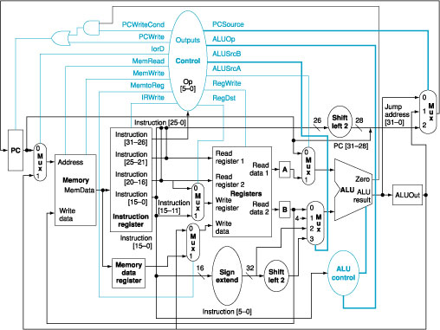
A MIPS Computer Architecture

Slide 75
MIPS Memory Allocation
Space for saved procedure information
heap: Explicitly created
space, e.g., malloc
Variables declared
once per program
MIPS Machine Program

